Slide 1

True-or-Trick: An AI-Based Deepfake & Misinformation Detection
By team Doit

Slide 2
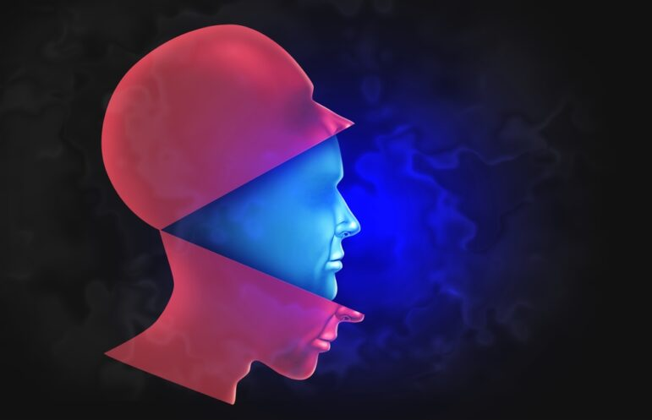
Problem Statement
In today's digital era, deepfake technology is advancing at an alarming rate, leading to misinformation, fraud, and security threats. Fake videos and images are being used to spread false narratives, manipulate public opinion, and even commit identity theft. The lack of reliable and efficient detection mechanisms makes it difficult to identify manipulated content in real-time, creating a major challenge for organizations, media platforms, and governments.

Slide 3
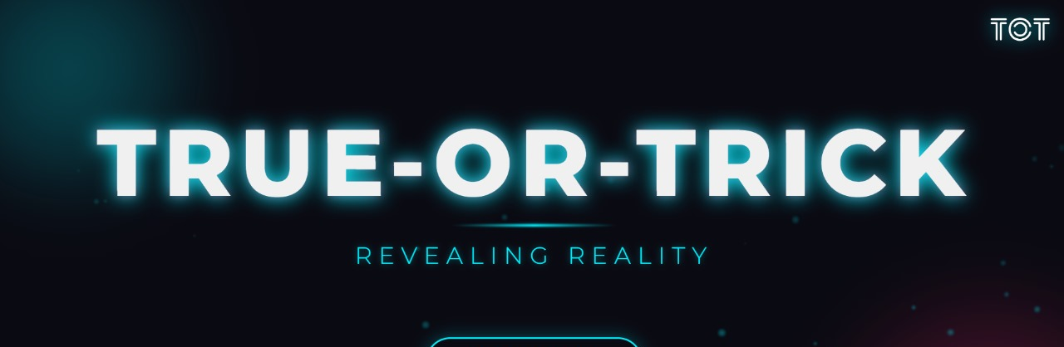
Solution Overview
True or Trick is a unified, AI-driven deepfake detection framework designed to analyze both visual and textual content for authenticity.
It consists of three core modules, each specialized for a different modality:
DeepScan (Image Analysis)
FrameGuard (Video Analysis)
TruthLens (News Verification)

Slide 4
DeepScan (Image Analysis):
Utilizes a pretrained EfficientNetB3 model.
Identifies artifacts, distortions, and patterns common in fake images.
Optimized for high accuracy and generalization across image-based
deepfakes.
FrameGuard (Video Analysis):
Employs a custom-trained EfficientNetB0 model.
Extracts keyframes from video and performs frame-wise classification.
Detects temporal inconsistencies and pixel-level manipulations.
TruthLens (News Verification):
Uses SerpAPI to scrape the web for relevant news and sources.
Performs automated fact-checking by comparing extracted headlines with trusted media outlets.
Enhances multimodal verification by integrating natural language understanding.
Together, these modules enable fast, accurate, and scalable detection of deepfakes in real-time across various content types.

Slide 5
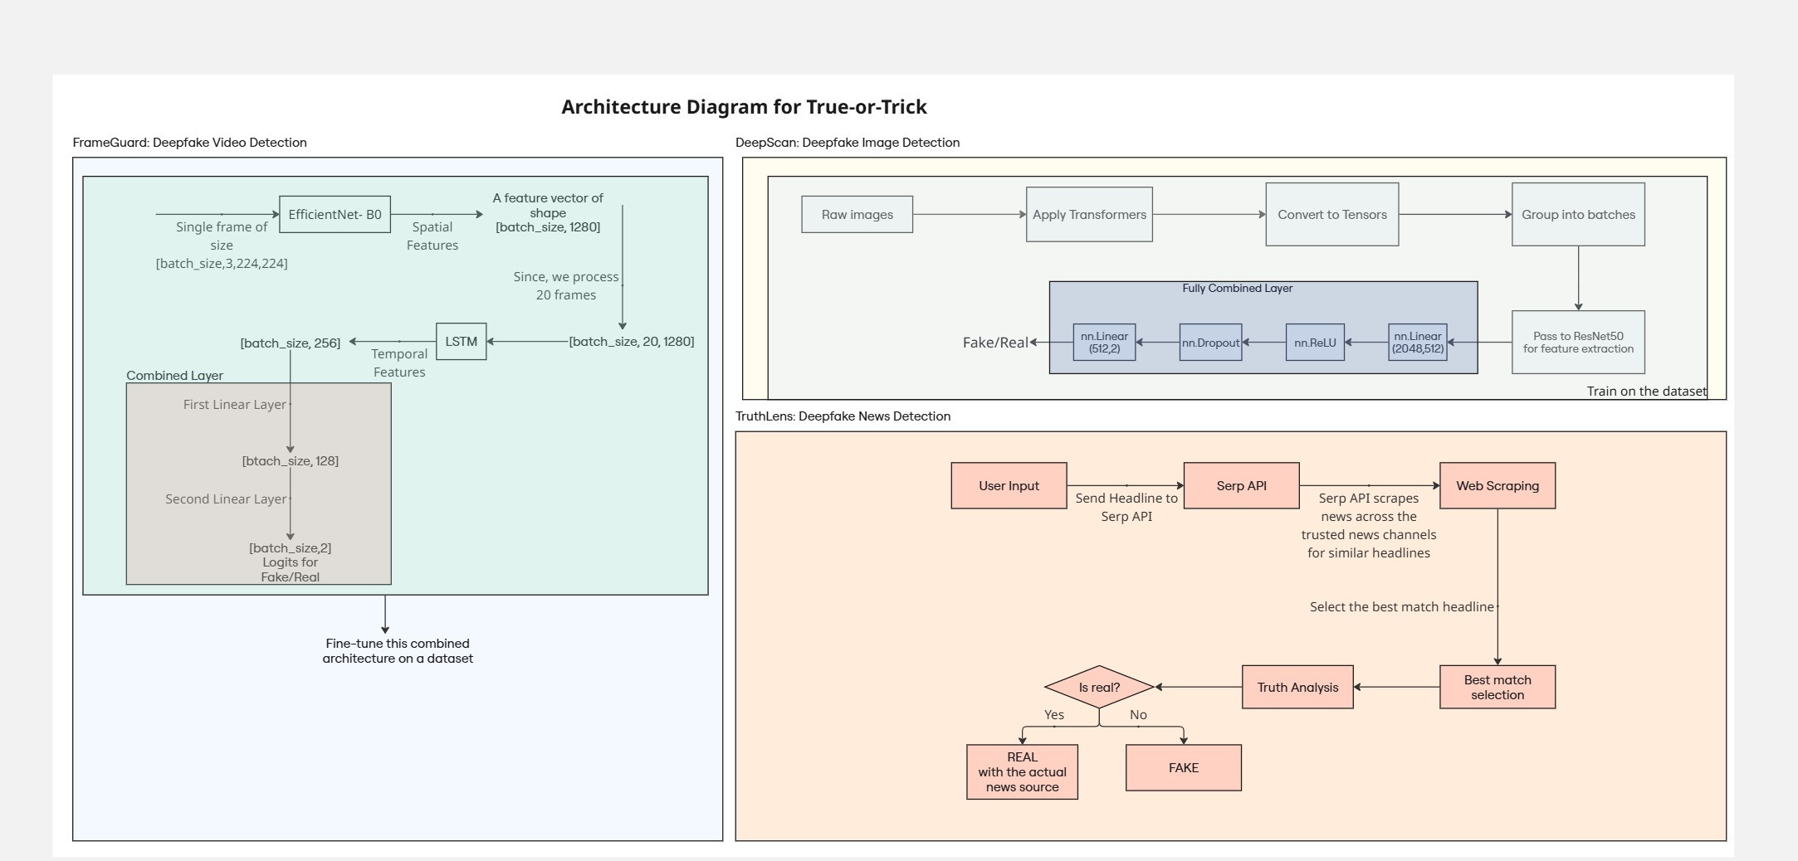

Slide 6
Conclusion
True or Trick presents a comprehensive and scalable framework for deepfake detection by combining image, video, and text verification.
It effectively leverages EfficientNet architectures and automated web scraping to detect manipulated content with high accuracy and speed.
The modular design ensures adaptability to evolving deepfake techniques and makes it suitable for real-time deployment in:
News media verification
Social media moderation
Cybersecurity systems
By merging deep learning with intelligent fact-checking, this work lays the foundation for robust, multimodal defense mechanisms against digital disinformation.

